Slide 1
Sexual dimorphism in snapping shrimps
Solomon Chak
Virginia Scientists & Educators Alliance – VA SEA
2016

Slide 2
I. Background

Slide 3
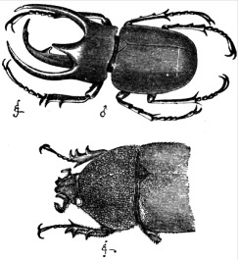
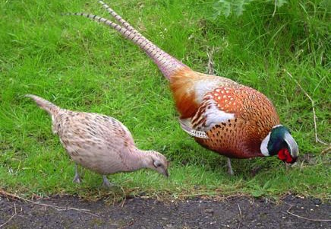
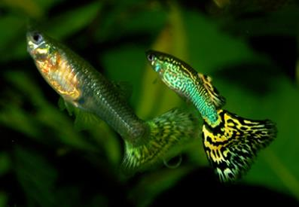
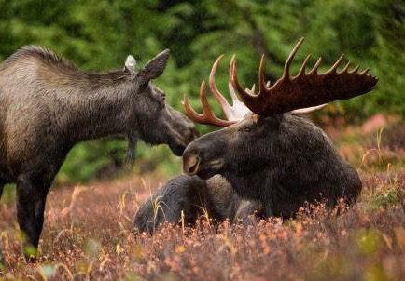
Fencing Whales Video
Top: Darwin (1871) Descent of Man, public domain
Bottom: Marrabbio2, Wikimedia Commons
Top : ChrisO at English Wikipedia
Bottom: Hagerty Ryan, U.S.FWS , public domain
Notes:
QQQ: These pictures show a general feature that is observed in many animal, what is it?
→ Males differ from females in plumage, color pattern, size, horn and antler…
Video: show the “Fencing whale” or “Showing off”. Comment/note about the cost associated with these secondary sexual characteristics.

Slide 4
Sexual Dimorphism
The two sexes exhibit different secondary sexual characters (i.e., beyond gonads/sexual organs)
Can include size, color, plumage, special structures, behavior, etc.
Usually, morphological traits related to competition or mate attraction are more pronounced in males
Why?
SEXUAL SELECTION
Top : ChrisO at English Wikipedia
Bottom: Hagerty Ryan, U.S.FWS , public domain

Slide 5
Natural selection
Natural selection is the differential survival and reproduction of individuals due to differences in phenotype (Zimmer & Emlen 2013)
One of many mechanisms* of evolution
* Other mechanisms of evolution are mutation, genetic drift, recombination & gene flow
Notes:
Sexual selection is a mode of natural selection. So to understand it we should first review about natural selection.
QQQ: What are the other mechanisms of evolution, apart from natural selection?

Slide 6
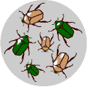
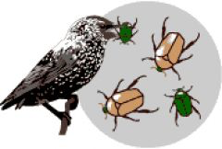
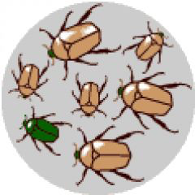
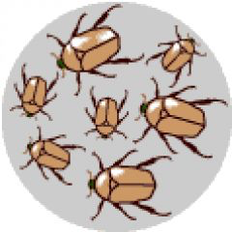
Natural selection at work
Ancestral population
Extant population
Variation
in trait
Differential
reproduction
Trait is
heritable
“Adapted”
“Organisms better adapted to their environment would benefit from higher rates of survival than those less well equipped to do so.” (Brennan 2010)
LEARN MORE: The University of California Museum of Paleontology's
Understanding Evolution (http://evolution.berkeley.edu)
Notes:
QQQ: In this example, what’s being selected against? (NOT size, but being green!)
QQQ: What is the selective force or agent? (predation by birds)
QQQ: How long did it take for the ancestral population to evolve into the extant (currently living) population? (usually takes several generations at least, depending on the strength of the selective force)

Slide 7
Sexual selection
Evolution of “secondary” sexual characters
Darwin observed that these characters did not appear to increase survival, and may be a result of competition between the same sex either for breeding opportunities or to attract the opposite sex
Selection that “depends on the advantage which certain individuals have over others of the same sex and species solely in respect of reproduction.”
(Darwin, The Descent of Man and Selection in Relation to Sex)
Trait usually involves some costs to produce, so only the sex that can benefit from it would have it
Notes:
Secondary sexual characters = traits other than the gonads themselves.
QQQ: Who was the first scientist to propose sexual selection as a possible driver of change in species? (Darwin)

Slide 8

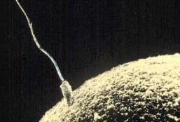

Males often carry the sexually selected trait
Bateman’s Principle: variability in reproductive success is greater in males than in females
At each reproductive cycle:
Male can mate multiply to increase reproductive success, because sperms are
cheaper to make.
Female CANNOT mate multiply, because eggs are more expensive to make.
Competition
→ 10,000 sperm
→ 1 egg
Choosiness
Photo credit: Public domain
Notes:
QQQ: Why is that males are usually the one that have these exaggerated traits?
Female choosiness drives male competition.

Slide 9


Sexual selection at work
Ancestral population
Extant population
Variation in a
heritable trait
Sexual dimorphism
Males with stronger
trait increase
reproductive success
Notes:
If the ancestral populations includes males with different strength (& strength is a heritable trait) and females pick the strongest (male with the largest, strongest arm), then in successive generations, more males will have large/strong arms. Female choosiness can drive male characteristics and greater sexual dimorphism can develop.

Slide 10
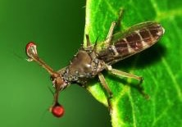
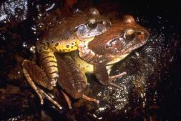
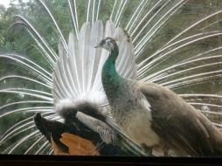
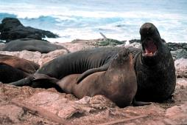
Sexual selection & dimorphism
In essence, males compete for females and selection favor traits in males that increase competitiveness
Stalk-eyed flies
Frogs & toads
Peacocks
Elephant seals
Photo credits: Hauke Koch, Wikipedia; Whiteghost.ink, Wikipedia; 2002 Jean-Marc Hero; Jan Roletto, public domain
Notes:
QQQ: Can you come up with examples of animals that are sexually dimorphic?
(pictures show more examples of sexually dimorphic animals due to sexual selection)

Slide 11
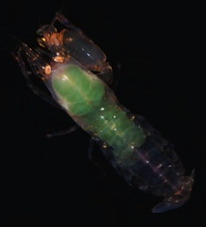
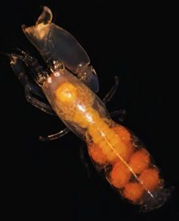
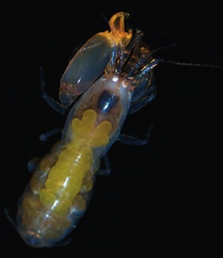
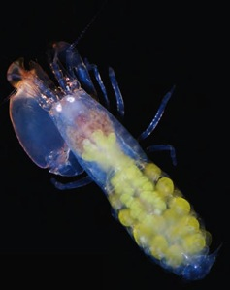
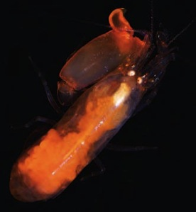
Investigation:
Snapping Shrimp Dimorphism
Day 1
Photo credit: Encyclopedia of Life
Notes:
This exercise is based on the PhD research of Dr. Solomon Chak, formerly a VIMS graduate student.

Slide 12
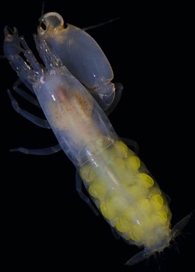
Snapping shrimps
Kingdom Animalia, Phylum Arthropoda, Subphylum Crustacea,
Class Malacostraca, Order Decapoda, Family Alpheidae
Weird Nature – BBC: snapping shrimps
Powerful snapping claw=major chela
vs. much smaller=minor chela
The snapping claw is used for competition and as secondary sexual character in some species.
Synalpheus bocas
Photo credits: Journal of Crustacean Biology (16(3): 564-573. 1996) by J. Emmett Duffy; S. bocas: Macdonald et al. 2009
Notes:
QQQ: Why are they called snapping shrimps?

Slide 13
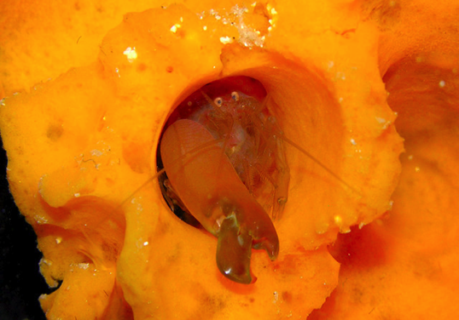
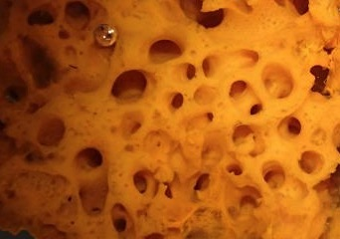
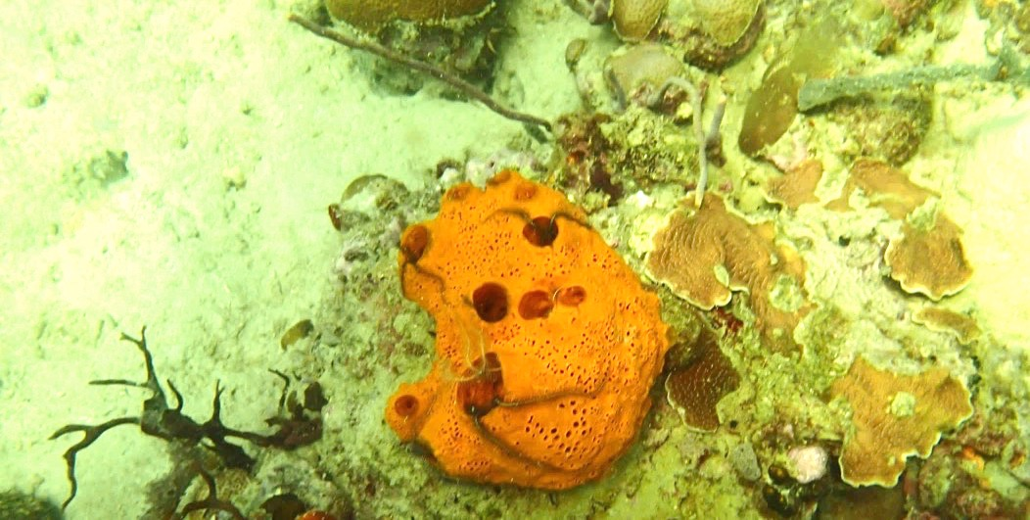
Synalpheus: Sponge-dwelling snapping shrimps
Hultgren KM, Duffy JE (2010)
S. Chak
Left: Synalpheus guarding a canal opening; Right: sponge canals
Bottom: The sponge Lissodendoryx colombiensis on coral rubble in Panama
Photo credit: S. Chak
Notes:
Synalpheus (pronounced: sin-AL-fee-us) live exclusively inside sponge canals.
A single sponge can have as much as several hundred shrimps within!
Different Synalpheus species of can be found in the same sponge

Slide 14



Synalpheus social structures
Pair-forming
*Communal
In communal species, shrimps frequently encounter other potential mates in the same sponge, allowing for opportunity for competition among males and female mate choice.
Eusocial
Notes:
Synalpheus species have three general types of social structures.
Pair-forming = a single breeding pair living in a sponge – typical for most snapping shrimps
Communal = multiple breeding pairs living within the same sponge.
Eusocial = a large colony living within a sponge, including a single breeding “queen” and many non-breeding individuals – much like ants and bees.
We will explore whether sexual selection are operating in communal species because they have high potential for sexual selection to be in operation.
QQQ: Why?
(We will get into eusocial species in the next class)

Slide 15
II. Hypothesis & predictions

Slide 16
General hypothesis & specific predictions
Hypothesis: Sexual selection is operating in snapping shrimp Synalpheus yano, a communal species.
Q1.
i) What specific prediction(s) can you make from the hypothesis? In other words, what pattern in the data will support your hypothesis?
ii) How would you test your prediction(s)?
S. yano
Photo credit: Rios & Duffy 2007 Zootaxa
Notes:
Synapheus yano is a communal snapping shrimp species, with many breeding males and female living together. In order to test the hypothesis that sexual selection is operating, what kind of data would you need to collect? And, what pattern in the data would support the hypothesis posed here.

Slide 17
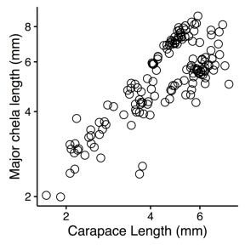
General hypothesis & specific predictions
Q2. Figure 2 shows the relationship between carapace length and chela length in log-scales.
How do you describe this pattern?
Chela size increase with carapace size
Mathematically according to:
y = kxª
or log y = a log x + log k
Notes:
Note the log scales on the Y and X axes. Why is it important to note that chela size vs carapace length is a log relationship?

Slide 18
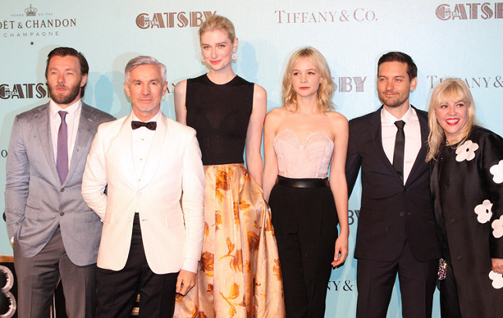
Why Allometry?
Eva Rinaldi, flickr
Notes:
To illustrate the concept of allometry, consider this photo of male and female celebrities:
If we only compared the averaged arm length of the males versus the females, the results would be biased by the tallest girl (Elizabeth Debicki). Female would appear to have much longer arms than males. This is not a fair comparison between males and females, because they don’t have the same height.
However, if we consider the concept of allometry, and compare the arm length divided by height, then the difference between male and females would be much less biased. We would have a much more accurate result.

Slide 19
Allometry
A colony of shrimp includes individuals that are of different ages.
As a shrimp grows larger, chela size increases with carapace length; this is called allometric scaling.
This means that we cannot simply compare the distributions of male and female chela lengths, because these are dependent on carapace length.
Image: Asia Society @ Flickr
Notes:
In our shrimp colonies, there are shrimp individuals of many ages. Claw size increases as the shrimp grows, this is allometric scaling. Since claw length is dependent on carapace length (shrimp age), we have to account for that. We can’t just compare distributions of male and female claw lengths.

Slide 20
Allometry
Q2. ii) Based on this pattern, modify how you will test your prediction(s).
Compare “relative” chela sizes
(chela size /carapace length)
between males and females.

Slide 21
III. Morphometric measurements
Notes:
Distribute the “Snapping Shrimp Worksheet” for Day 1

Slide 22
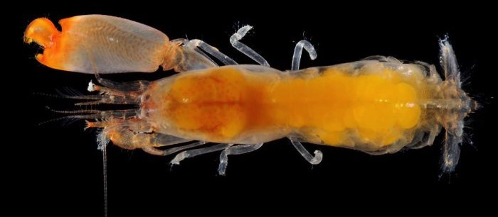
Shrimp measurements
1. carapace length, 2. chela length
chela length
carapace length
S. agelas
Photo credits: Anker et al., 2012
Notes:
You are going to record both carapace length and major chela length for shrimp from different species. We’ll do this based on photographs all taken at the same scale.

Slide 23
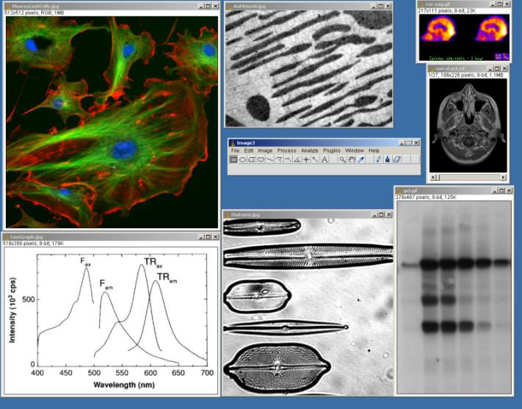
Shrimp measurements
ImageJ: See separate handout for instruction
Photo credit: public domain
Notes:
To do this, we’ll use ImageJ, a very versatile image analysis program used in science. It was developed by the National Institutes of Health (NIH), a federal research agency. See: https://imagej.nih.gov/ij/docs/intro.html
We’re using the very basic function of the program: measuring distance.

Slide 24
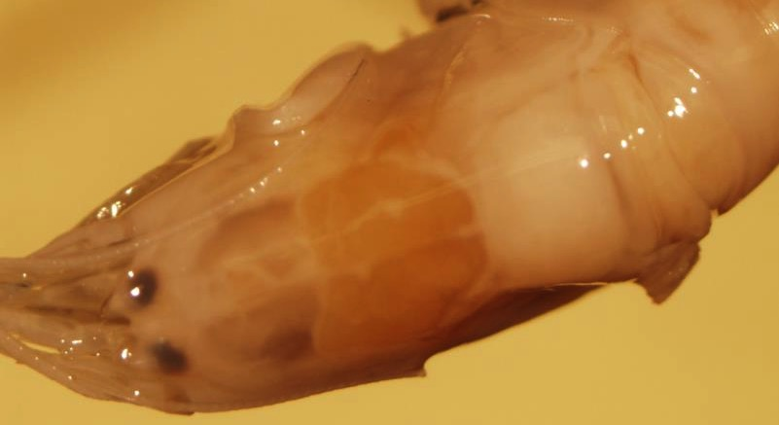
Shrimp measurements
1. carapace length demo
Start at the base of the two “dips” around the rostrum
End at the middle of the carapace. Note the distinctive contour with a notch at each side
Notes:
Measure carapace length starting at the rostrum, that’s the small spike on the shrimp’s head, right between the 2 eyes.
End at the center of the carapace (the exoskeleton covering the mid body of the shrimp), look for the distinctive contour with a notch on each side. These measurements will be in millimeters (mm)

Slide 25
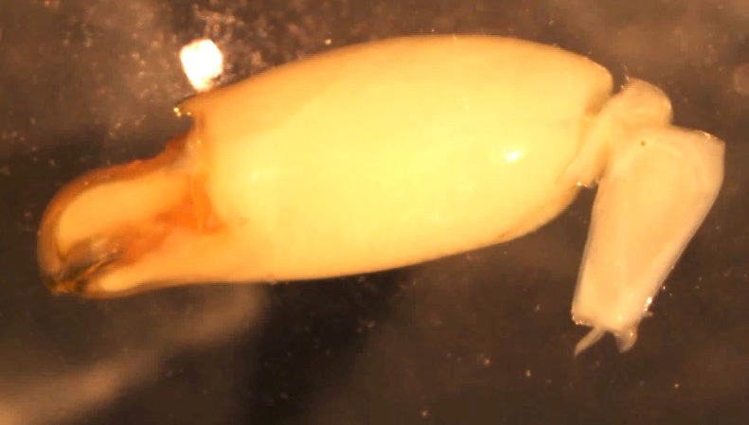
Shrimp measurements
2. chela length demo
End with the longest diagonal distance
Start at tip of the fixed finger
Notes:
Measure the length of the major chela starting at the tip of the fixed (smaller) finger and extending to the longest diagonal distance. The measurements will again be in mm.

Slide 26
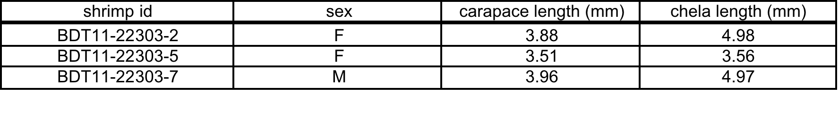
Shrimp measurements
- Your turn! -
As a class, you will measure carapace and chela lengths for 75 male and female S. yano
*** Note that if the picture file says (X2), you will need to divide the measurement by 2. This because the pictures were magnified.
Arrange the data in four columns as shown below
Pool data from all groups for further analysis
Notes:
There are images for 75 male and female shrimp (Synalpheus yano), sampled from 4 different colonies. Have pairs of students measure images from different colony folders – most folders contain images for ~10 male and ~10 female shrimp (20 shrimp total). Since carapace and claw sizes are measured for each shrimp there will be roughly 40 measurements to take in each folder.
Work with a partner to measure carapace and chela lengths for male and female shrimp assigned to you.
Note: If the pictures were magnified (x2), you will need to divide your measurements by 2.
Per the instructions in the Snapping shrimp worksheet, record data in a Excel spreadsheet.
It is imperative that students enter their data in the same format so that you can combine all measurements. If possible, have the students enter data into a shared spreadsheet, e.g. a Google Document Sheet. You will pool the data and distribute it to students for the next session of this lesson.

Slide 27
IV. Statistics Review
Notes:
Wrap-up Day 1 with a statistics review… Or, start Day 2 with this.

Slide 28
Independent two-sample t-test
e.g., H₀ = Female body sizes are the same as male
Compare the means of a continuous variable between two treatments
Test the null Hypothesis that
mean₁ = mean₂
P < 0.05 ?
Males
Females
mean₁
mean₂
Notes:
Independent two-sample t-test

Slide 29
Investigation:
Snapping Shrimp Dimorphism
Day 2
Notes:
These are true color images of snapping shrimp. Why do you think there is so much color variation? What are the large, round structures inside the shrimp?

Slide 30
V. Data analysis
Notes:
It is imperative that students enter their data in the same format so that you can combine all measurements. If possible, have the students enter data into a shared spreadsheet, e.g. a Google Document Sheet. You will pool the data and distribute it to students for the this lesson.

Slide 31
Independent two-sample t-test
Compare the means of a continuous
variable between two treatments
Test the null Hypothesis that
mean₁ = mean₂
P < 0.05 means?
H0: Mean relative chela size _{M} = Mean relative chela size _{F}
(relative chela size = chela length/carapace length)
Males
Females
mean₁
mean₂
Notes:
We will use an independent two-sample t-test to examine the data you collected during the last session.

Slide 32
t-test using Excel
You can use the t.test function in Excel to perform t-test
Instruction video
=t.test (group-1-values, group-2-values, 2, 2)
For the last two numbers:
2 means it's a two-tailed test;
2 means it assumed equal variance between samples
Notes:
Use the t.test function in Excel to perform the t-test. Review the tutorial video
As explained in the video, the settings to insert are: (group-1-values, group-2-values, 2, 2)

Slide 33
Results & Conclusion
Q3. Present your results graphically in Excel.
Q4. What is the P-value of the t-test? Can we reject the null hypothesis?
Notes:
Demonstrate two ways of plotting data, as illustrated in the files: “Communal_species_morphometric_S.yano.xlsx”
Figure 1 shows bar plot comparing the mean of female to male.
Figure 2 is a bar plot comparing the distribution of relative claw sizes of females and males
Students work on data analysis and discuss results.

Slide 34
Results & Conclusion
Q5. What conclusion can you draw from the test? Does it support your hypothesis?

Slide 35
VI. Sexual selection in eusocial shrimps?
Eusocial shrimps in BBC Blue Planet

Slide 36
Synalpheus social structures
Eusocial
Eusocial species live in large colony with usually one reproductive female “queen” and many “workers”
The presence of the queen can “turn off” the reproductive organs of the female workers
Pair-forming
Communal
Notes:
Compare/contrast sexual dimorphism in communal vs. pair-forming vs. eusocial species.

Slide 37
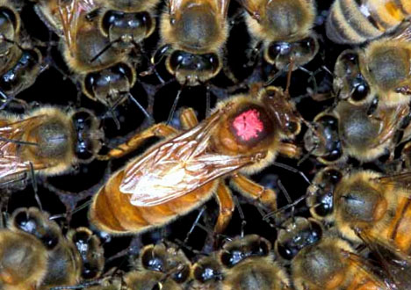
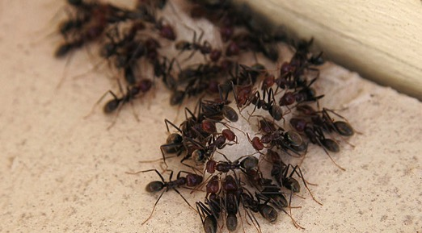
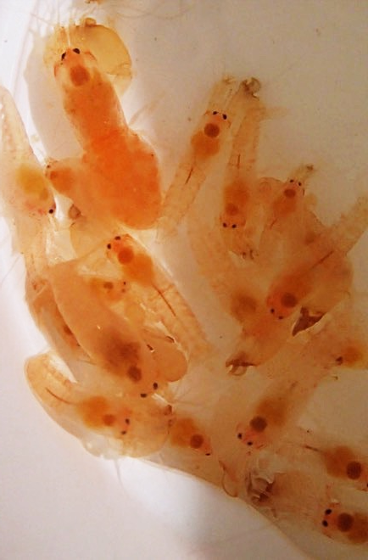
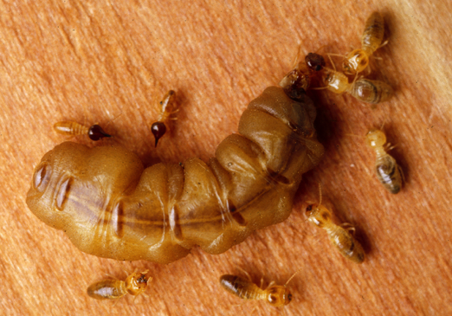
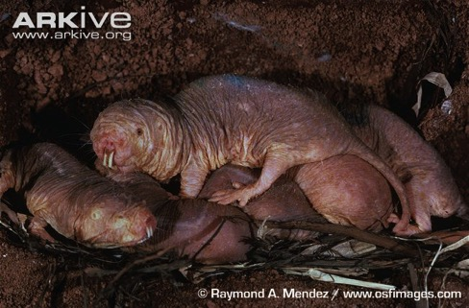
Synalpheus is the only eusocial animal documented in the sea!
Photo credits: Bees: public domain; Ants: Fir0002/Flagstaffotos, naked mole-rats: Raymond A.Mendez; termites: CSIRO
Notes:
Eusociality – worker sacrifice their own reproductive output to help the queen
QQQ: what are other examples of eusocial species? (show in the pictures are bees, ants, termites, and naked mole-rats)

Slide 38
Sexual selection in eusocial shrimps?
Download: “Eusocial_species_morphometric_S.regalis.xlsx”
Q6. i) Graphically present the data. ii) Present the t-test results.
Notes:
In their same groups, students work on data analysis of eusocial shrimp species as provided in “Eusocial_species_morphometric_S.regalis.xlsx”

Slide 39
Sexual selection in eusocial shrimps?
Q7. Does the result from eusocial species support the prediction of sexual selection?
- NO. Eusocial shrimp S. regalis is not sexually dimorphic.
Q8. Come up with a different hypothesis to explain the pattern here.
Notes:
Discuss hypotheses for why we aren’t seeing sexual dimorphism in this eusocial species.

Slide 40
Sexual selection in eusocial shrimps?
Communal
Eusocial
Males compete for females
Relative claw size:
  Male > Female
‘Sexually dimorphic’
Males compete for Females
Females compete to be queen
Relative claw size:
  Male = Female
‘Sexually monomorphic’
Notes:
Knowing that workers can become queen means that workers can compete for becoming queen..
Hypothesis = sexual dimorphism will reduce in more eusocial species

Slide 41
Consequence of eusociality:
Reduced sexual dimorphism
S. yano (Pair-forming)
Male > Female
S. brooksi (Eusocial)
Male = Female
Male
Female
Female
Male
Data: Chak et al. (2015) Proceedings B
Photo credits:Rios & Duffy 2007 Zootaxa ; Anker et al 2012 Zootaxa
Notes:
Effect of sexual selection on males is balanced out if females CAN also compete in eusocial group – NOT for males, but for the dominant breeding position.
(Note: The images on the right show S. brooksi to illustrate male and female shrimps, but the data for eusocial species is from S. regalis. Both S. regalis and S. brooksi are eusocial)

Slide 42
Sexual selection in eusocial shrimps?
Effect of sexual selection on males are balanced out by that females CAN also compete in eusocial group
Females compete NOT for males, but for the dominant breeding position

Slide 43
VII. The case for reversed sexual dimorphism
Why are females larger than males in some species?

Slide 44
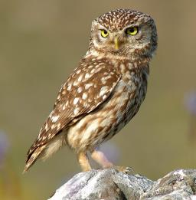
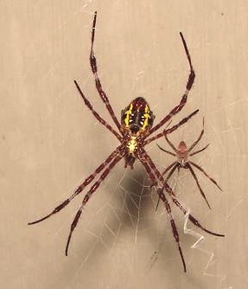
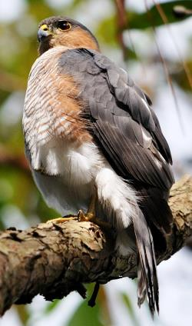
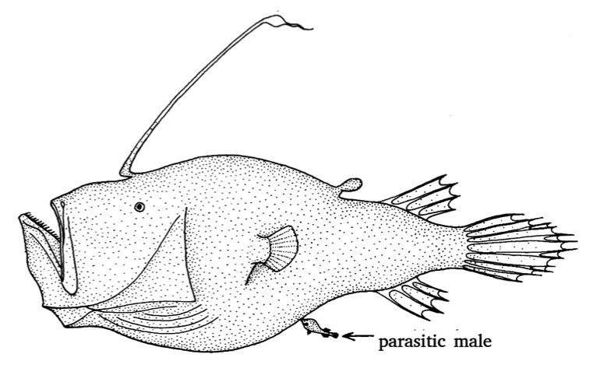
F >>> M
F > M
Athene_noctua
Sibi
Mike Morel
Sanba38
Photos: Wikimedia Commons
Notes:
"Cryptopsaras couesii triplewart seadevil" by Commons sibi - Own work. Licensed under CC BY-SA 3.0 via Commons - https://commons.wikimedia.org/wiki/
"Male and female A. appensa" by Sanba38 at English Wikipedia. Licensed under CC BY 2.5 via Commons - https://commons.wikimedia.org/wiki/File:Male_and_female_A._appensa.jpg#/media/File:Male_and_female_A._appensa.jpg
"Athene noctua (cropped)" by Athene_noctua_(portrait).jpg: Trebol-aderivative work:Stemonitis (talk) - Athene_noctua_(portrait).jpg. Licensed under CC BY-SA 3.0 via Commons - https://commons.wikimedia.org/wiki/File:Athene_noctua_(cropped).jpg#/media/File:Athene_noctua_(cropped).jpg
"Puerto Rican Sharp-shinned hawk perched on tree limb" by Mike Morel/U. S. Fish and Wildlife Service - This image originates from the National Digital Library of the United States Fish and Wildlife Serviceat this pageThis tag does not indicate the copyright status of the attached work. A normal copyright tag is still required. See Commons:Licensing for more information.See Category:Images from the United States Fish and Wildlife Service.Transferred from en.wikipedia; transferred to Commons by User:Innotata using CommonsHelper.. Licensed under Public Domain via Commons - https://commons.wikimedia.org/wiki/File:Puerto_Rican_Sharp-shinned_hawk_perched_on_tree_limb.jpg#/media/File:Puerto_Rican_Sharp-shinned_hawk_perched_on_tree_limb.jpg

Slide 45
Reverse sexual dimorphism
Hypothesize why this could have evolved?
What is the prediction from your hypothesis?
How would you test your hypothesis?
Consider possible confounding factors.

Slide 46
Reverse sexual dimorphism
Possible hypotheses:
Ecological difference between sexes
Breeding role differentiation
Notes:
More specific examples:
female hawks need larger prey than males;
larger female can better protect eggs/ juveniles/ nest
eggs are so “expensive” to make that the females have larger body size to support the expenditure
For spider: sexual cannibalism

Slide 47
References
Zimmer, Carl; Emlen, Douglas J. (2013).
Evolution: Making Sense of Life (1st ed.).
Greenwood Village, CO: Roberts and Company Publishers.
Brennan, P. (2010) Sexual Selection.
Nature Education Knowledge 3(10):79

