Slide 1
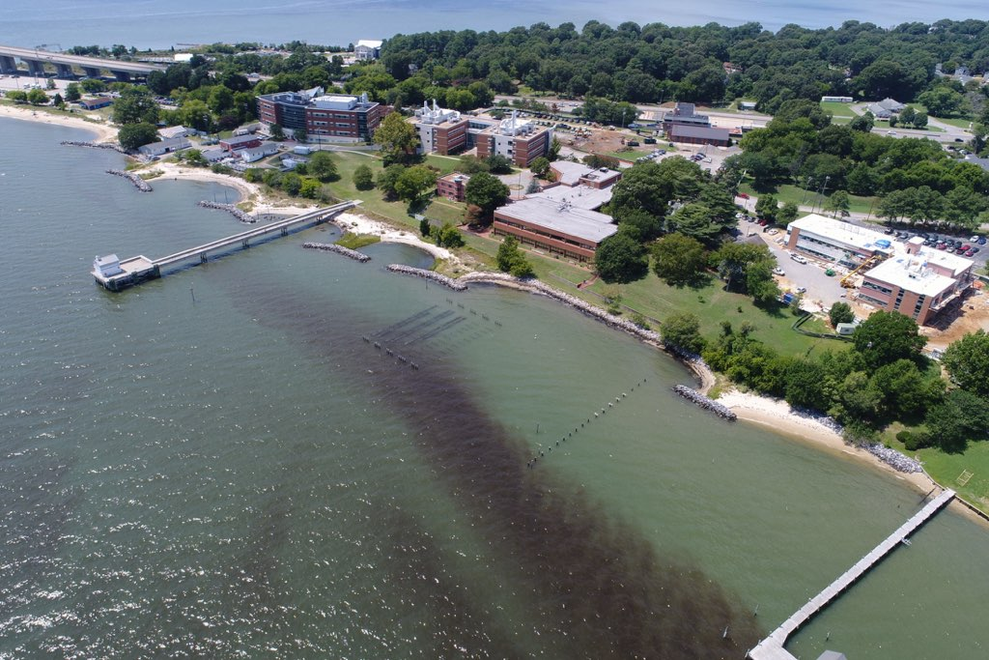
What’s going on in the water?
Credit: D. Gong/VIMS
Notes:
(Ask the students to describe what’s going on in the water in this photo. If they need prompting…ask them about the color of the water, is it uniform? What color is it, red, brown?)
This is a red tide right here in the Chesapeake Bay! What do you know about red tides?
Today’s lesson will be about the harmful algae in red tides.
Bloom at VIMS: D. Gong/VIMS
https://www.flickr.com/photos/vims_photos/36505709025/in/photolist-XBTiCD-xwe18v-X3Dw3y-XsvBy7-XBTiht-XBTisi-XnMSmL-X1PmSs-XsvAtS-cHDTg7-XnMSGW-cHJZ8y-cHJYYy-X3Dujd-XBTi6X-xTmPX4-cHJY4q-xARFYg-xR3cxj-XnMS8j-xAK68N-XBThXk-cHJYEQ-XBThJp-xLprfh-XBThwR-Pq2USY-XxMGqE-X1Pm4U-Pq2Wfh-cHJZUs-Wop9i6-cHJYuQ-xMSE5G-X3DwRh-Pq2W9f-NeSMXD-cHJYLs-257GxSN-XsxCM5-NeSN64-NeSLJ6-XvpT3B-25bomgn-xw7d6d-dH8vci-xwe1st-dSkmYA-dSkmUw-dHdSML

Slide 2
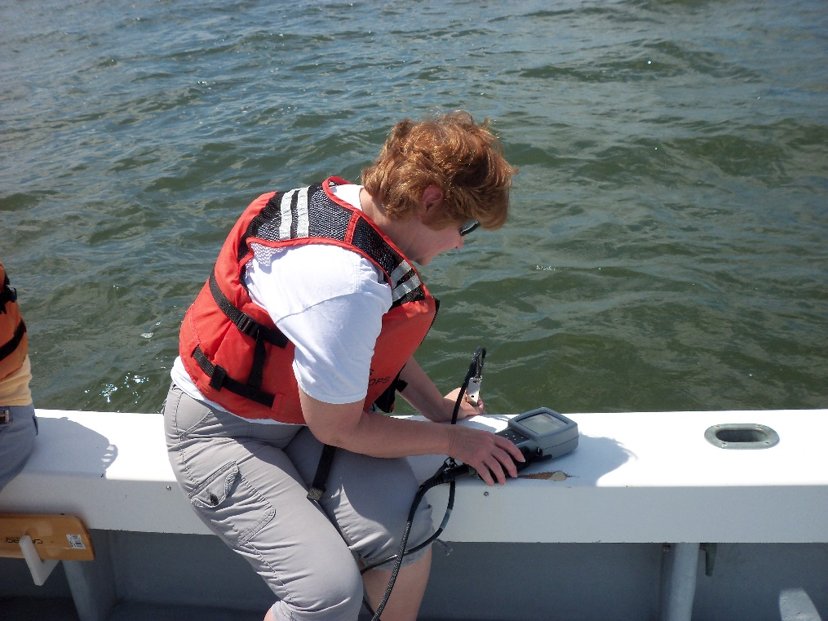
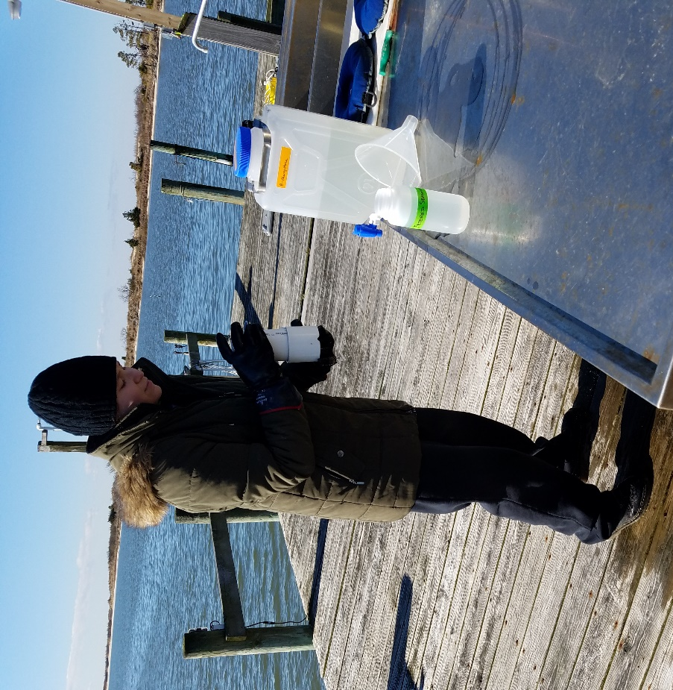
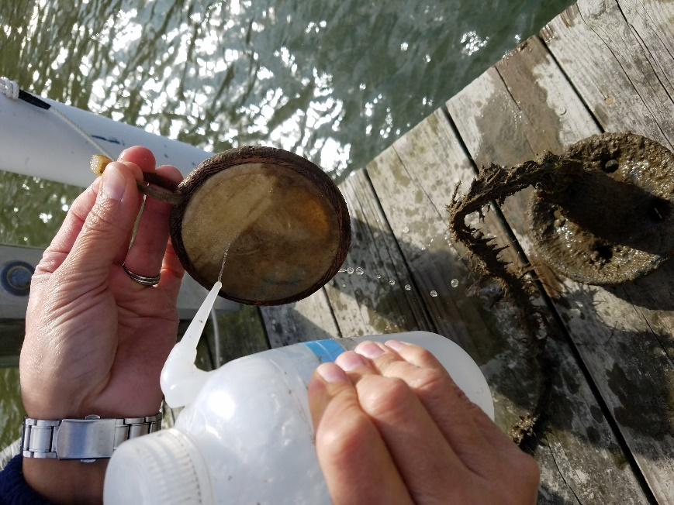
TINY KILLERS: Monitoring Harmful Algae
Researcher Dr. Kimberly Reece using an instrument to measure water quality. Credit: S. Pease/VIMS
A Solid Phase Adsorption Toxin Tracking (or SPATT) disc after it has been removed from the water. Credit: S. Pease/VIMS
Masters student Michelle Onofrio sieving water samples to collect phytoplankton. Credit: S. Pease/VIMS
Notes:
Today we are going to talk about harmful algae, what it is, and how people monitor it to ensure public health and safety.

Slide 3
Part I: Introduction
What are harmful algae?
Notes:
So, what are harmful algae?

Slide 4
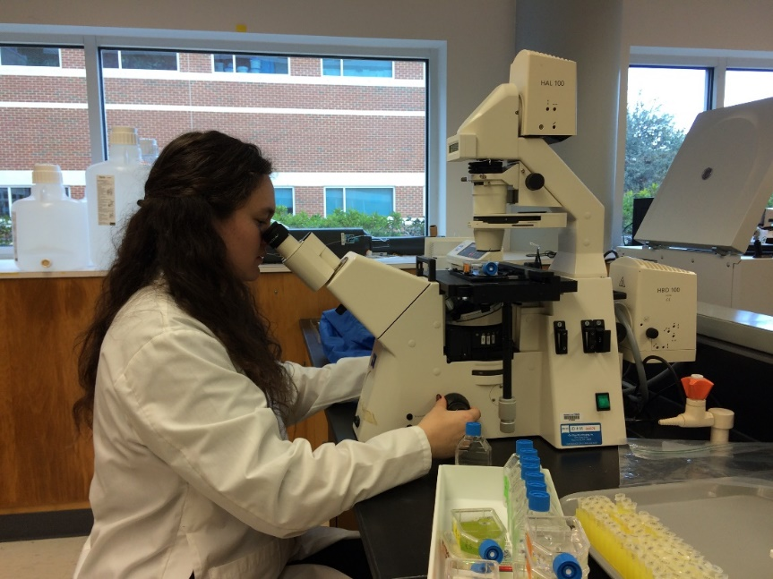
Harmful Algae
Phytoplankton:
microscopic, drifting, photosynthetic, plant-like organisms (Fisher, 2012)
Phytoplankton that
naturally produce toxins
and/or
form large patches that can deplete oxygen from the water and block sunlight
Impact: water quality, ecosystem health, organism health, recreation, human health, seafood safety
PhD student Sarah Pease examining harmful algae under a microscope. Credit: J. Smith/VIMS
Notes:
Harmful algae are phytoplankton (reminder definition of phytoplankton in orange box)
…that naturally produce toxins or are able to form large patches in the water that can use-up oxygen from the water and block sunlight…harming other animals and plants in the environment
Harmful algae can have negative impacts on water quality, ecosystem and organismal health, recreation, human health and seafood safety for humans
Fisher, R. J. (2012). Health concerns for people and wildlife. In J. Brown, L. Mohan, K. Dell & C. Zillmer (Eds.), One ocean (pp. 88-103). Retrieved from https://www.nationalgeographic.org/media/one-ocean-teacher-guide/

Slide 5
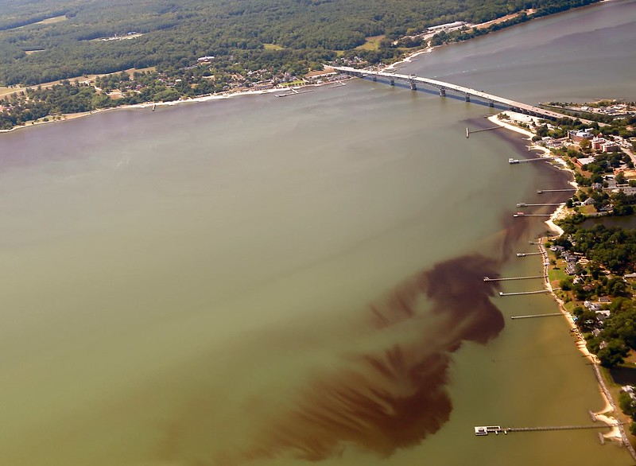
Harmful Algal Blooms (HABs)
Sudden increase in cell concentration
Usually one or a few species
Short-lived (days to weeks)
Also called “red water”, “red tide”, or “brown tide”
Bloom of Alexandrium monilatum in the York River. Credit: W. Vogelbein/VIMS
Notes:
When environmental conditions are right, some species of harmful algae can form large patches called: Harmful algal blooms (aka HABs).
A “bloom” occurs when there is a sudden increase in harmful algae cell concentration in an area. Generally, blooms are made up of only one or a few species of algae.
These events generally only last from a few days to a few weeks and they occur at different times of the year for different algae species.
You may have also heard these events referred to as…red water, red tide, or brown tide. As we’ve seen, this is because some species of algae are reddish or brownish and when the cell concentration in the water is high enough, the color of the water appears darker.
Amon bloom: https://www.flickr.com/photos/vims_photos/36386965016/

Slide 6
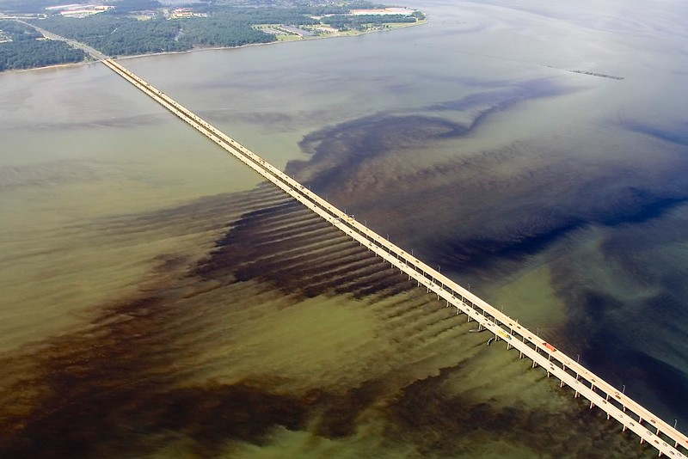
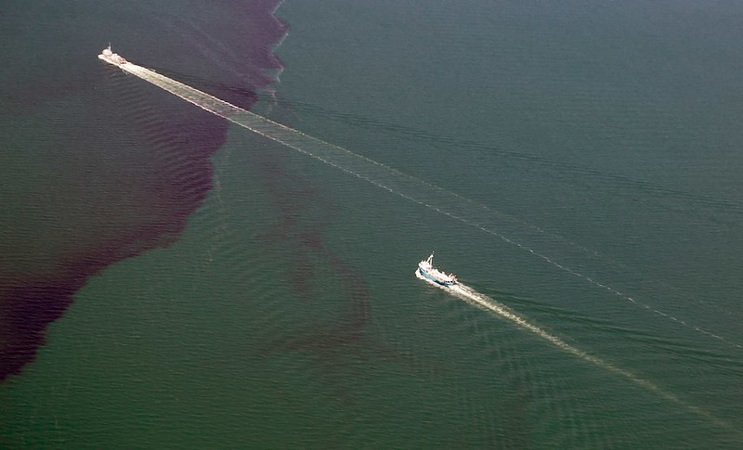
The HAB-tastic Chesapeake Bay
Bloom of Margalefidinium polykrikoides in the James River.
Credit: W. Vogelbein/VIMS
Two fishing boats and a bloom of Alexandrium monilatum in the Chesapeake Bay.
Credit: W. Vogelbein/VIMS
Notes:
Here is what some recent harmful algal blooms have looked like. (These pictures were taken from an airplane by a VIMS HAB researcher Dr. Wolfgang Vogelbein.)
Notice how streaky and patchy these blooms can be! The wind and currents can move these blooms around fairly rapidly, within minutes to hours!
Each of these two blooms is predominantly made-up of just one harmful algae species, on the left: Margalefidinium polykrikoides (or “Marge” for short!), and on the right: Alexandrium monilatum (or “Amon” for short, pronounced A-mon).
These are just two of the common bloom-forming HAB species we get in the Chesapeake…
Pronunciation guide
Alexandrium monilatum (Alex-and-REE-um mon-ill-ate-um): https://www.flickr.com/photos/myfwc/8621534507
Margalefidinium polykrikoides (Mar-ga-lef-i-din-EE-um polly-krick-OY-DEES):
Marge bloom (left): https://www.flickr.com/photos/vims_photos/36400022846/
Amon bloom (right): https://www.flickr.com/photos/vims_photos/36432451225/

Slide 7
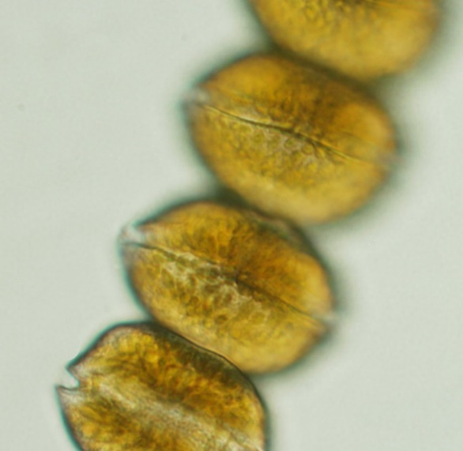
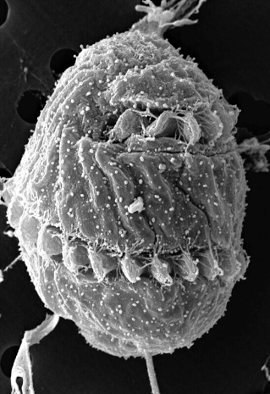
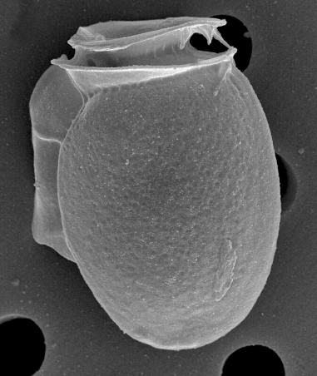
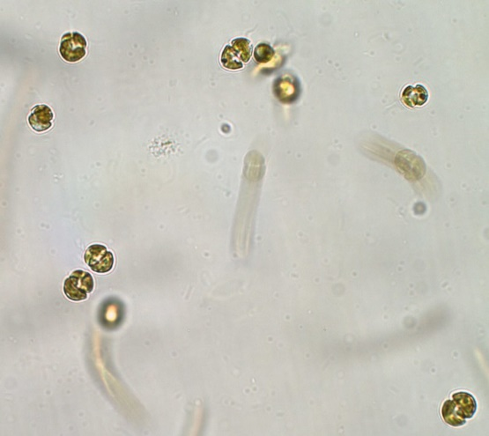
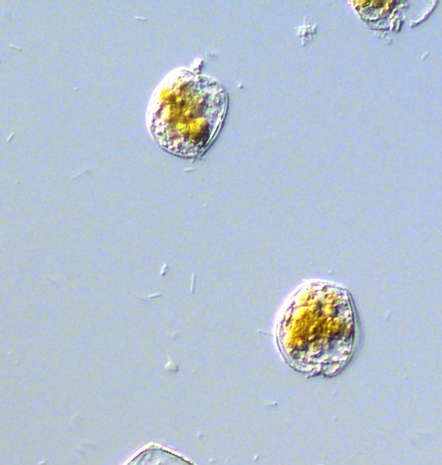
Harmful Algae Species of the Chesapeake Bay
37 known species of harmful algae in the Chesapeake Bay
(Marshall et al. 2008)
Amon: Alexandrium monilatum. Credit: FWC Fish and Wildlife Research Institute
Marge: Margalefidinium polykrikoides (prev. Cochlodinium). Credit: FWC Fish and Wildlife Research Institute
Dinophysis acuminata. Credit: FWC Fish and Wildlife Research Institute
Karlo: Karlodinium veneficum. Credit: FWC Fish and Wildlife Research Institute
Proro: Prorocentrum cordatum. Credit: NMFS/NOAA
Notes:
…all in all, there are at least 37 known species of harmful algae in the Chesapeake Bay. Some of these, like “Marge” and “Amon” turn the water red. While others, like “Karlo” and “Proro” are associated with fish kills, and still others, like Dinophysis (pronounced: DINO-fy-sis), don’t form blooms, but produces a toxin that can cause Diarrhetic Shellfish Poisoning…a human illness.
Credits, pronunciation, and definitions
Alexandrium monilatum (Alex-and-REE-um mon-ill-ate-um): https://www.flickr.com/photos/myfwc/8621534507
Margalefidinium polykrikoides (Mar-ga-lef-i-din-EE-um polly-krick-OY-DEES): https://www.flickr.com/photos/myfwc/5842734422
Dinophysis acuminata (DINO-fy-sis ah-QUEUE-mi-nata): https://www.flickr.com/photos/myfwc/8622944494
Prorocentrum cordatum (PRO-row-scent-rum CORE-dot-um): https://www.flickr.com/photos/noaaphotolib/16086541862
Karlodinium veneficum (CAR-lo-din-EE-um ven-eff-ick-um): https://www.flickr.com/photos/myfwc/8678782150
Diarrhetic (Die-ah-ret-ic): of or relating to diarrhea
Marshall, H. G., Egerton, T. A., Johnson, R., Semcheski, M., Bowman, N., & Mansfield, N. (2008). Re-occurring harmful algal blooms in the tidal waters of Virginia, USA. Ocean Sciences Meeting; March 2-7, 2008; Orlando, Florida.

Slide 8
Harmful Algae Toxins
Okadaic acid
&
Diarrhetic Shellfish Poisoning
Dinophysis acuminata. Credit: FWC Fish and Wildlife Research Institute
Notes:
…today we are going to focus on non-bloom-forming, toxin-producing harmful algae that pose a risk to human health, like Dinophysis. Dinophysis produces okadaic acid, the toxin responsible for causing Diarrhetic Shellfish Poisoning. So, to start…how does the toxin okadaic acid, created by this microscopic organism, end up in oysters?
Pronunciation guide:
Okadaic acid (OAK-a-day-ick)
Dinophysis acuminata: https://www.flickr.com/photos/myfwc/8622944494

Slide 9
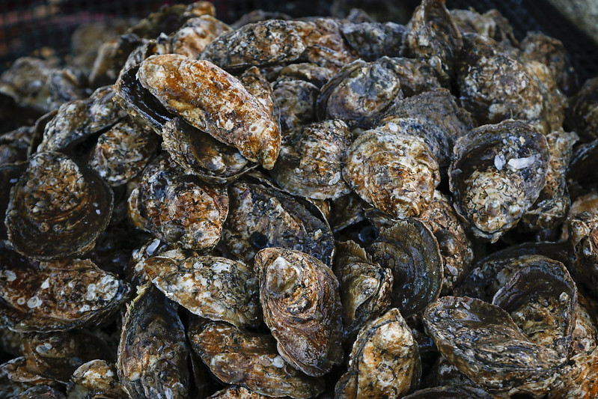
Harmful Algae Toxins
Okadaic acid
&
Diarrhetic Shellfish Poisoning
?
Oysters. Credit: M. Huxford/VASG
Dinophysis acuminata. Credit: FWC Fish and Wildlife Research Institute
Notes:
…and how would a scientist track the toxins Dinophysis produces?
Oysters: https://www.flickr.com/photos/virginiaseagrant/49018370878/in/photolist-2hFzXTu-2hFDEUa-2hFDEov-2hFzWXm-2hFCCqy-2hFDDWJ-2hFDFjP-2hFCDEc-2hFDEYU-2hFDEQH-2hFzXjZ-2hFzXeD-2hFzX9J-2hFzX6h-2hFCCEm-2hFCCA3-2hFCCx2-2hFzVx7-27kfJuL-28ZBdES-2gapCbq-27FDDG7-REcD6i-27LPkzd-28ZBbV9-256BwxN-28ZBeJf-SH28DN-27qGEGC-LDn11U-28ZBhhm-K874ZT-LQYZQq-26Kz6q5-2gapdhe-28GHpcb-2gapd81-LUACZ7-MXCnnf-28ZBaTj-2akA7JK-2agjQJo-2akA7zM-K874rP-28wcHjH-K86VhH-LUADHG-2agjRSA-2agjRhN-LDmZLA
Dinophysis acuminata: https://www.flickr.com/photos/myfwc/8622944494

Slide 10
Bioaccumulation Demo
Notes:
(Perform the Bioaccumulation Demo now, see the Procedure in the lesson plan.)

Slide 11
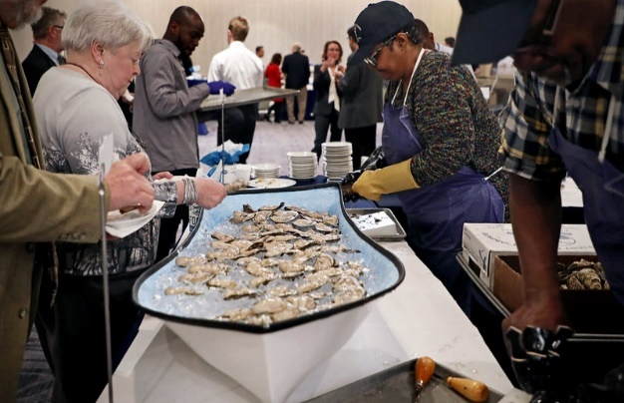
Bioaccumulation Discussion
Oysters are filter-feeders
Bioaccumulation within an organism
Biomagnification up the food web
Regulatory limits for toxins in shellfish
People eating oysters. Credit: A. Devlin/VASG
Oysters. Credit: M. Huxford/VASG
Dinophysis acuminata. Credit: FWC Fish and Wildlife Research Institute
Notes:
(Review main points of activity): oysters are filter-feeders that OVER TIME can bioaccumulate toxins, like those produced by some species of harmful algae. These toxins become biomagnified as you move up the foodweb, meaning that humans get exposed to a higher amount of toxin than the oysters do, in some cases, making people sick. This is why there are regulatory limits for harmful algae toxins in oyster and other filter-feeding shellfish meat…to reduce the chances of anyone getting ill.
People eating oysters: https://www.flickr.com/photos/virginiaseagrant/46967817112/in/photolist-2eyokGd-2a4CKr8-nW18Dg-9LAXEZ-2dwZ7gC-2bHihJP-LeoBfd-b8yRmz-27kfLgw-2dfdZKM-2dfdZPK-2eCYnuD-2eCYqLP-bhYCwg-bhYGic-9wUJVR-LeoACG-25BgJoS-nUfS8y-28GHmYo-2amC23Y-2eyoiDW-2dwZ7pd-LeoBaU-K86UVa-MXCij5-2eCYmr6-2eCYqv8-2a4CEwt-242wTJR-2eyokjE-2eCYpCB-2eCYnJX-242wSa8-2eCYpVv-2eCYmAz-2eCYoTF-27FDEts-R8cJt4-LeoC1S-RTAVRJ-Sb5kPH-27pbGDk-242wTkV-2eCYnRR-2eyohR3-2eCYmb6-242wT9T-2dwZ7iw-2eyokpu
Oysters: https://www.flickr.com/photos/virginiaseagrant/49018370878/in/photolist-2hFzXTu-2hFDEUa-2hFDEov-2hFzWXm-2hFCCqy-2hFDDWJ-2hFDFjP-2hFCDEc-2hFDEYU-2hFDEQH-2hFzXjZ-2hFzXeD-2hFzX9J-2hFzX6h-2hFCCEm-2hFCCA3-2hFCCx2-2hFzVx7-27kfJuL-28ZBdES-2gapCbq-27FDDG7-REcD6i-27LPkzd-28ZBbV9-256BwxN-28ZBeJf-SH28DN-27qGEGC-LDn11U-28ZBhhm-K874ZT-LQYZQq-26Kz6q5-2gapdhe-28GHpcb-2gapd81-LUACZ7-MXCnnf-28ZBaTj-2akA7JK-2agjQJo-2akA7zM-K874rP-28wcHjH-K86VhH-LUADHG-2agjRSA-2agjRhN-LDmZLA
Dinophysis acuminata: https://www.flickr.com/photos/myfwc/8622944494

Slide 12
Part II: Monitoring to protect Human Health
How do we prevent people from being impacted by harmful algae?
Notes:
Now that we know that toxins produced by harmful algae can bioaccumulate in oysters and other filter-feeding shellfish, and biomagnify up the food web, let’s talk about what these toxins do to humans and how monitoring can be used to prevent people from getting sick.

Slide 13
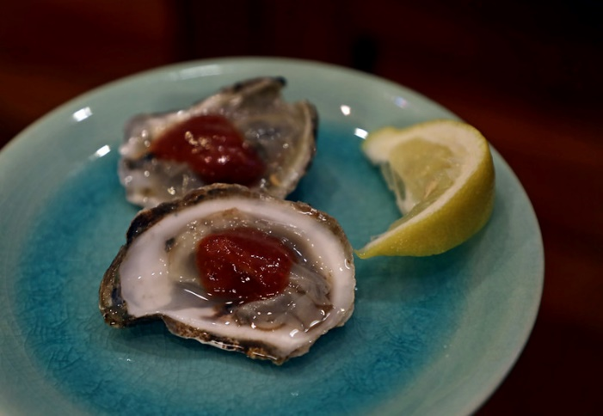
HAB-related Human Poisoning Syndromes
HAB
Species
Toxin
Syndrome
Alexandrium catenella
Paralytic Shellfish Poisoning (PSP)
Domoic acid
Amnesic Shellfish Poisoning (ASP)
Dinophysis spp.
Diarrhetic Shellfish Poisoning (DSP)
Saxitoxin
Pseudo-Nitzschia spp.
Okadaic acid
Karenia brevis
Azadinium spinosum
Brevetoxin
Neurotoxic Shellfish Poisoning (NSP)
Gambierdiscus toxicus
Ciguatoxin
Ciguatera Fish Poisoning (CFP)
Azaspiracid
Azaspiracid Shellfish Poisoning (AZP)
Oysters. Credit: A. Devlin/VASG
Notes:
These are some of the most common human illnesses that are caused by the biomagnification of harmful algae toxins in seafood. Notice that almost all of these illnesses are associated with filter-feeding shellfish (again this is because filter-feeders can easily bioaccumulate harmful algae toxins). You can also see that most of these illnesses are caused by a specific toxin, produced by a specific harmful algal species.
Symptoms of these illnesses can be as mild as a severe stomach ache (DSP, CFP), to as serious as paralysis or death (PSP).
(OPTIONAL: have students break into small groups to quickly look-up some of the symptoms of these specific illnesses and share them with the class. Here are a couple good resources: https://www.whoi.edu/redtide/page.do?pid=9257 and http://www.fao.org/3/y5486e/y5486e00.htm#Contents)
Oysters on the half shell: https://www.flickr.com/photos/virginiaseagrant/45073375822/in/photolist-aPiCL4-e1C965-aPiAvk-2bEYQxE-aPiyue-aPiALX-aPiyJT-2bEYQim-aPizG2-9LATot-bhZV8F-bhZX36-PBjRoA-9LAX16-bhYLC2-bhZT4c-bhZYqR-9LDFEs-9LAY8z-9LDK4d-9LAXEZ-9LAWt6-9LAYmD-bhZQYt-9LDGWY

Slide 14
Monitoring To Protect Human Health
Traditional methods of monitoring for toxin-producing harmful algae include basic water and shellfish (e.g., oyster) sampling
VIMS researchers monitoring for harmful algae. Credit: J. Smith/VIMS
Notes:
In the Chesapeake Bay, we use a lot of traditional methods to monitoring for toxin-producing harmful algae, including basic water and shellfish (e.g., oyster) sampling

Slide 15
Water Samples
Collected at one point in time
Harmful algae cell concentration and identification
Microscopy
Genetic techniques
Water sample from an Alexandrium monilatum bloom. Credit: J. Krenn/VASG
Notes:
Water samples, often called “grab samples”, are collected by hand at a specific time point. They tell you what species of algae were in the water at the time the sample was collected, and in what cell concentrations. Scientists use microscopy to identify and count cells, or sometimes genetic techniques using DNA are performed to identify species and quantify their cell concentrations in the sample. The downside of this method is that water moves, and what is in the water at one location at one minute may be completely different than what is in it a second later, especially with streaky, patchy blooms of algae being moved by winds and currents.
Water sample: https://www.flickr.com/photos/virginiaseagrant/21040018166/in/photolist-qR1NNF-LUADFN-y4eAnU-2eDhPq3-27EnE9Z-2es4W2T-LUABCj-25es6pz-2eDhZem-2fR3s7g-25es7DD-25es9ap-28LXyiZ-2aa2RLx-28LXzbR-2a5L94u-28LXy3Z-294zhiU-28LXxWr-cNA3sj-cNA3As-bWfMBP-2es51me-bWgjWr-qQT2yQ-2es52Uz-S5wuC4-2eDhRQd-TGMnRA-2eDhX7f-2eDhYdy-2fR3tba-2fLrW7u-2es51tD

Slide 16
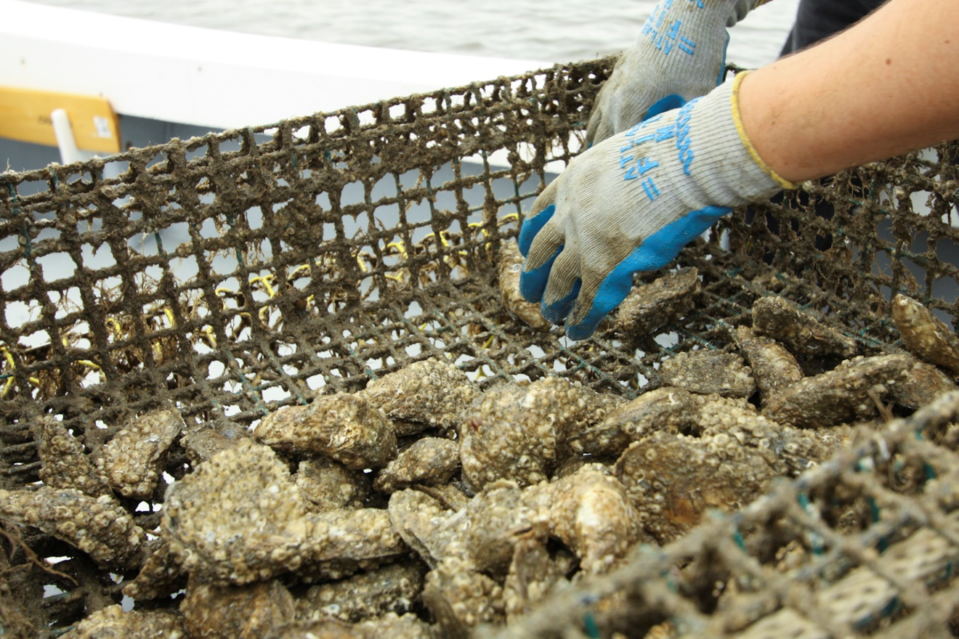
Shellfish Samples
Filter-feeding shellfish: often mussels, but also oysters, clams, etc.
Deployed in the water for weeks to months
Harmful algae toxin concentration and identification
Collecting an oyster sample from a cage. Credit: J. Krenn/VASG
Notes:
Shellfish samples have the advantage that the filter-feeding shellfish (usually mussels, but also oysters or clams) can be deployed wherever you want to monitor, and left for as long as you like. They also have the benefit of allowing you to test exactly what harmful algae toxin concentrations are in the shellfish meat that people might eat. The downside is that shellfish monitoring can be expensive and slower to get results from.
Oyster cage: https://www.flickr.com/photos/virginiaseagrant/20445184423/in/photolist-xNVZZ7-y6xYgV-y4eAmG-y6xYd8-qQJs2y-x9EV2H-y4eAnU-y7efzz

Slide 17
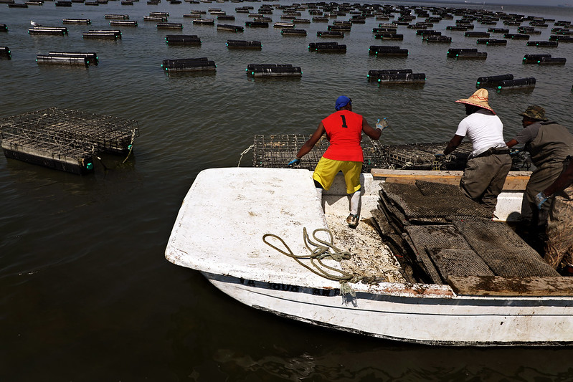
Closing Shellfish Harvest Areas
Occurs when toxin-producing harmful algae are at or above regulatory limits
Necessary to protect human health
Leads to watermen losing money
Re-opening is difficult, requires samples test below regulatory limits for a certain time period
An oyster farm in a shellfish harvest area. Credit: A. Devlin/VASG
Notes:
When monitoring samples show that toxin-producing harmful algae are at or above regulatory limits, shellfish harvesting areas must be closed to protect human health. Unfortunately, while shellfish harvest areas are closed, watermen lose a lot of money, hurting their livelihoods. For this reason, regulators try to make sure that harvest areas are only closed when they present a clear threat to human health, and they work to close harvest for as short a time as needed. Re-opening a closed shellfish harvest area is difficult and requires that samples from the closed area test below regulatory limits for a certain time period.
Oyster farm: https://www.flickr.com/photos/virginiaseagrant/48020420878/in/photolist-2gapd81-LUACZ7-MXCnnf-28ZBaTj-2akA7JK-2agjQJo-2akA7zM-K874rP-28wcHjH-K86VhH-LUADHG-2agjRSA-2agjRhN-LDmZLA-2agjSn3-27FDGcC-27FDF8U-28GHo7L-LUACVE-2akA892-MXCk1S-27FDDXs-Pjk6Xs-2akA8vz-28GHjEq-LUABLW-2akA8nP-2agjRu1-27FExqh-28GHmm1-2bHiiEB-MXCjgf-K873Gc-KHrmwE-2hzQNQF-2h8t11q-LUACP7-2hpEzTo-2eCYrcZ-28rNgNo-256BuM3-bhYDRp-b8yNiP-27pbGDk-256BxjY-RTAXcQ-2eyokGd-28Y8GJ6-b8yNQZ-bhYC9z

Slide 18
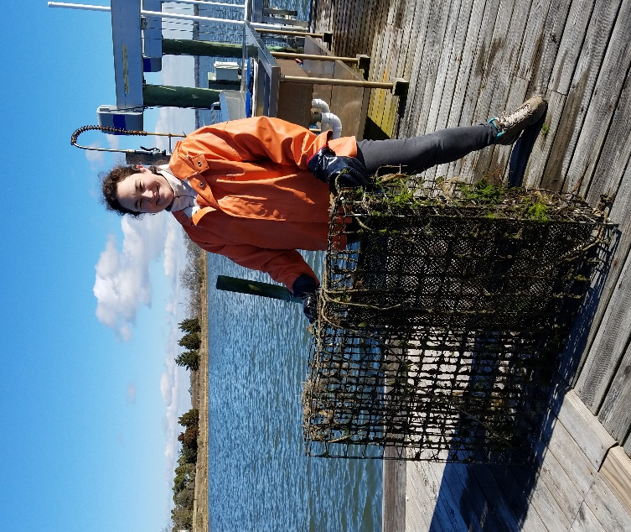
Meet a Scientist: Sarah Pease
I study marine science at the Virginia Institute of Marine Science (VIMS), where I work with harmful algae and oysters. I am researching how harmful algae affect oysters and how harmful algal toxins bioaccumulate in oysters in the
Chesapeake Bay.
This next activity is based on work that I did for my own research, using harmful
algae cell concentration data to determine
where to deploy shellfish for harmful algae
toxin monitoring around the Chesapeake
Bay.
PhD student Sarah Pease holding an oyster cage. Credit: S. Pease/VIMS
PhD student Sarah Pease shucking oysters. Credit: J. Krenn/VASG
Notes:
Now we are going to meet a scientist that does harmful algae monitoring in the Chesapeake Bay…(read slide)
Now it’s your chance to help decide how to monitor for harmful algae in UnHABitable Bay!
Oyster shucking: https://www.flickr.com/photos/virginiaseagrant/21073901051

Slide 19
Harmful Algae Monitoring Activity
Notes:
(Have students do the Harmful Algae Monitoring Activity now, see the Procedure in the lesson plan.)

Slide 20
Lab Results
 | Site
Season | 1 |  | 2 |  | 3 |  | 4
 | B toxin | C toxin | B toxin | C toxin | B toxin | C toxin | B toxin | C toxin
Winter | ND | ND | 76 | 6 | 48 | ND | ND | 2
Spring | ND | ND | 21 | ND | 50 | 3 | ND | 26
Summer | 25 | ND | 122 | 19 | 684 | ND | 8 | 11
Fall | ND | ND | 1854 | 43 | 97 | 2 | ND | ND
Notes:
Display these results when all groups are ready.
(This table matches the table in the Harmful Algae Monitoring Activity_ANSWER_KEY.docx.)

Slide 21
Monitoring Discussion
Notes:
(Use this slide as a backdrop to discuss any of the worksheet questions as a whole class. This is the same map from the Group Activity Sheet.docx.)

Slide 22
Part III: Advancements in Monitoring
What does the future of harmful algae monitoring in the Chesapeake Bay look like?
Notes:
Water and shellfish samples aren’t the only way that scientists are monitoring the Chesapeake Bay for harmful algae…let’s take a look at some of the new methods they are using to help provide early-warning and protect human health from harmful algae…

Slide 23
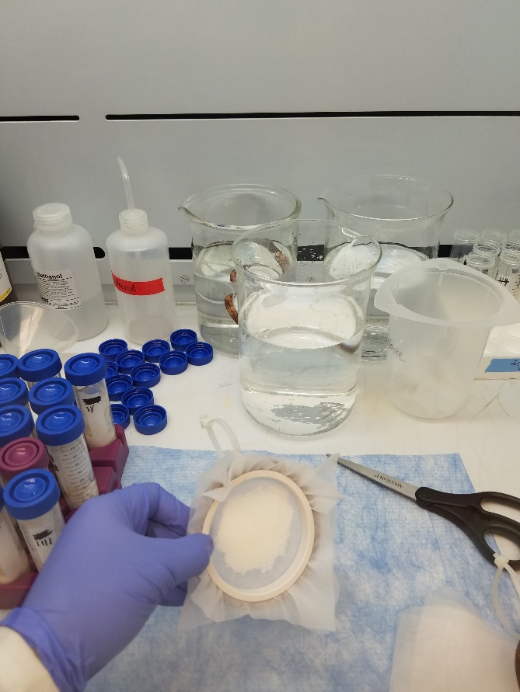
Solid Phase Adsorption Toxin Tracking Devices (SPATTs)
Handmade sampling device
Toxins adsorb onto the SPATT
Deployed in the water for 1-6 weeks
Harmful algae toxin concentration and identification
A new SPATT disc being prepared in the lab. Credit: S. Pease/VIMS
A SPATT disc after it has been removed from the water. Credit: S. Pease/VIMS
Notes:
One new method of monitoring for harmful algae toxins is to deploy SPATTs, or Solid Phase Adsorption Toxin Tracking devices, into the water. These handmade discs enclose a material that toxins in the water will adsorb to over the 1-6 week deployment period, then the discs are brought back to the lab, and the toxins on the disc can be identified and quantified. SPATTs can be deployed on their own, or in combination with water and shellfish samples.

Slide 24
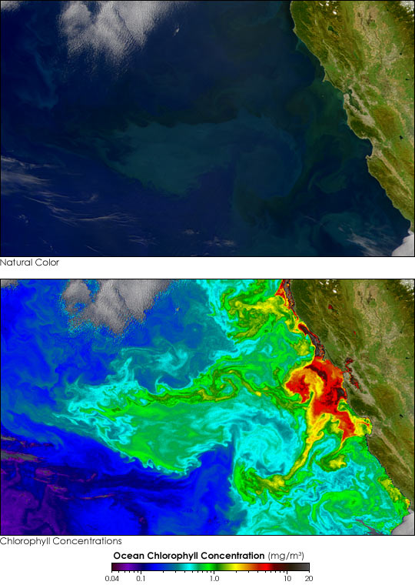
Satellite Imagery
Semi-continuous monitoring
Ocean color used to estimate harmful algae cell concentration
The Terra satellite. Credit: NASA
Ocean natural color and chlorophyll concentration. Credit: NASA
Notes:
Another method of detecting harmful algal blooms over a large area is to use special satellite imagery that can detect specific pigments in the water, produced by algae. Scientists can use the data from the satellite images to create maps of harmful algae blooms for areas much larger than most sampling would allow for.
Satellite: https://earthobservatory.nasa.gov/blogs/earthmatters/2018/08/24/how-scientists-are-tracking-red-tides-with-satellites-and-smartphones/
Chlorophyll: https://commons.wikimedia.org/wiki/File:Phytoplankton_Kalifornien.jpg

Slide 25
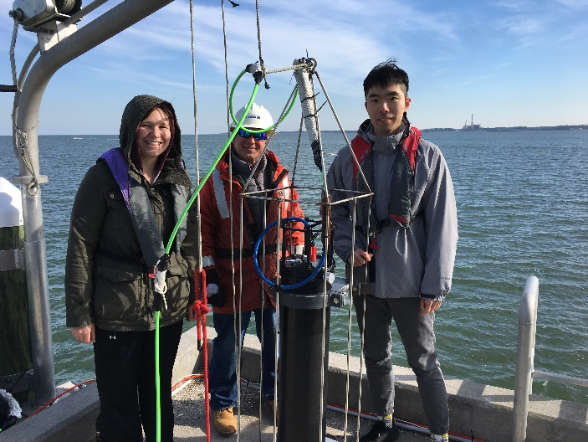
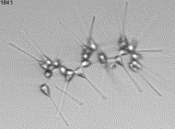
Imaging FlowCytobot (IFCB)
Continuous live monitoring
Harmful algae cell concentration and identification
The IFCB ready for deployment at VIMS. Credit: J. Smith/VIMS
Phytoplankton images captured by the IFCB. Credit: M. Onofrio/VIMS
Notes:
One of the more recent additions to the Chesapeake Bay harmful algae monitoring tool-kit is the IFCB, or Imaging FlowCytobot. This is essentially a robot that can be deployed into the water where it will take tiny water samples how ever often you set it to, and it will take photographs of every single phytoplankton in the water sample. A computer back at land then uses the photos to identify, categorize, and count the number of each type of algae. This technology may help scientists spot a harmful algal bloom before it happens!

Slide 26
Overview
Chesapeake Bay is home to at least 37 species of harmful algae, some of which produce toxins
Harmful algae toxins can bioaccumulate in filter-feeding shellfish, those toxins can be biomagnified up the food web, posing a risk to human health
In the Chesapeake Bay, monitoring for harmful algae is done using water and shellfish samples to track harmful algae cell concentrations and harmful algae toxin concentrations and ensure that they are below the regulatory limits
When the regulatory limits are exceeded, shellfish harvest areas are closed to protect human health

Slide 27
Wrap-up Discussion
What makes harmful algae “harmful”?
How do harmful algae toxins from microscopic algae make people ill? What processes are involved?
Describe some harmful algae monitoring methods and the pros and cons of each method.
How do scientists monitor for harmful algae and what considerations must they make when designing a monitoring plan?

